Slide 1

Midterm Collaboration Project AirBNB Europe
Mina Botros
Valérie Dier, P.Eng

Slide 2
PEOPLE PROCESS TOOLS EXPERIENCE
Find something to investigate
Present it in four days’ time
Collaborate
Can you use GitHub?
Figure out Deliverables
EDA, visualizations, maybe modelling?
Code it!
Commenting? Collaborating on GitHub yet?
Make it pretty
Play in Tableau – can you explain it?
Now deliver it!
Figured out GitHub yet?

Slide 3





Potential Challenges?
Clean data
colab
Intersection
TIME
Tableau
Squeaky-clean dataset
Zero Nulls
Not too big
Not too small
You’re an expert in GitHub, right?
GitHub experience: 1/10
Potential for overlaps and gaps: 10/10
There are strong coders
There are strong communicators
Both should come together to produce something good
There wasn’t much.
Pretty pictures are great… but are they saying anything?

Slide 4
Airbnb europe
Are prices per night?
Are prices in euros?
Who’s paying 18K!?!
The price is right?
No one wants
To hear you snore
A Kaggle user wanted to bless the world with “clean(ed) data”
Author: “Column names are self-explanatory”
18 features, mixed numericals & categoricals
No nulls! No messy strings!
Sounds great, right?
Mostly. Now predict the price of a listing.
Very little shared room data
Who’s booking?
Business?
Leisure?
Shady business?
(18K room)
3rd time’s a charm
3 columns to say nearly the same thing (room type)

Slide 5
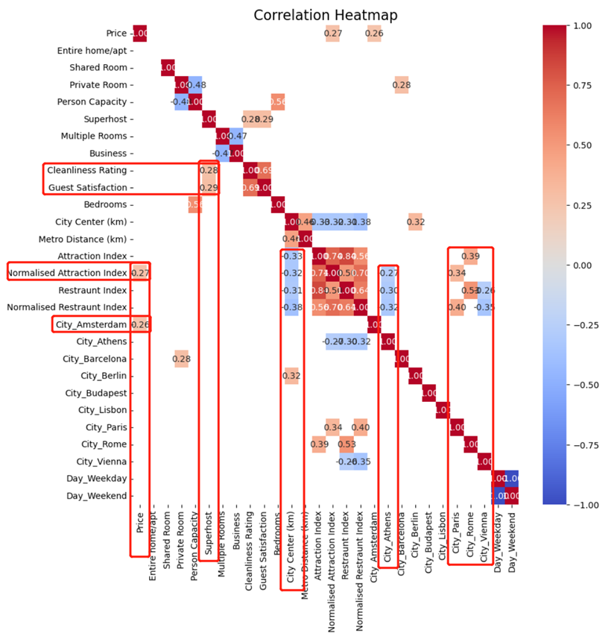
Only the parts of the heatmap with correlation coefficients greater than 0.25 in absolute value were extracted. Here are some pieces of information that can be observed from the heatmap:
The city of Amsterdam has the largest positive impact on prices in terms of the attraction index.
Superhosts were positively correlated with both cleanliness rating and customer satisfaction in the past.
The farther away from the city, the lower all the indices are.
The city of Athens has relatively low values for all indices. The restaurant index is also low in the city of Vienna. Both the cities of Paris and Rome show positive correlations with two indices.

Slide 6
Findings @ EDA Level
Negative correlation between indexes and the distance to the city center and the subway station. We naturally prefer shorter distances.
There is a significant positive correlation between indexes and price.

Slide 7
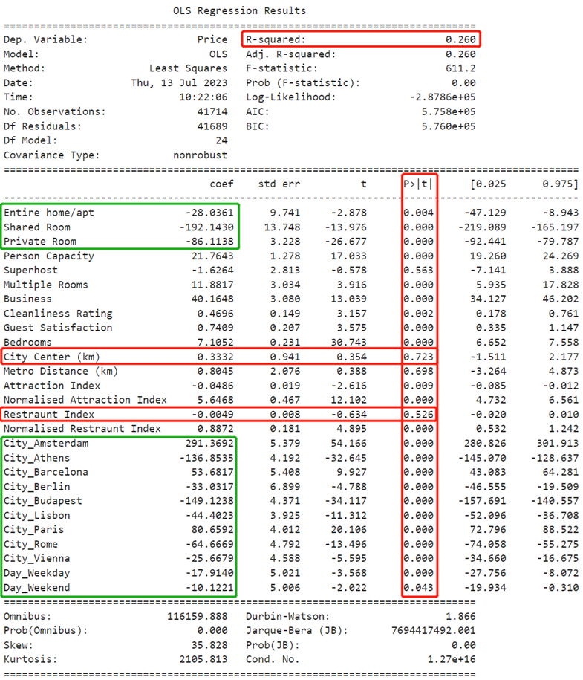
From the results of the regression analysis, the two factors that have the most significant impact on prices are:
City
Room type

Slide 8

Visualization Analysis: Prices

Slide 9
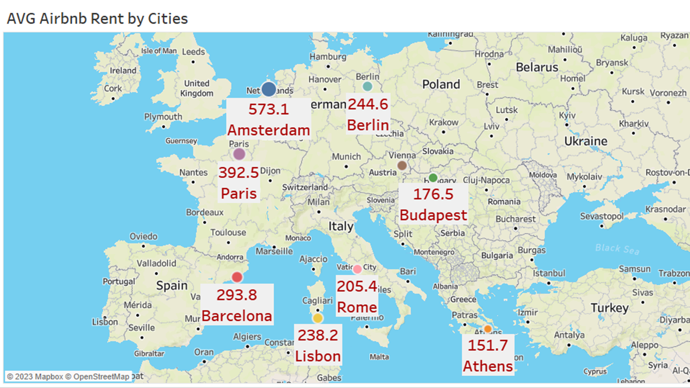

Slide 10
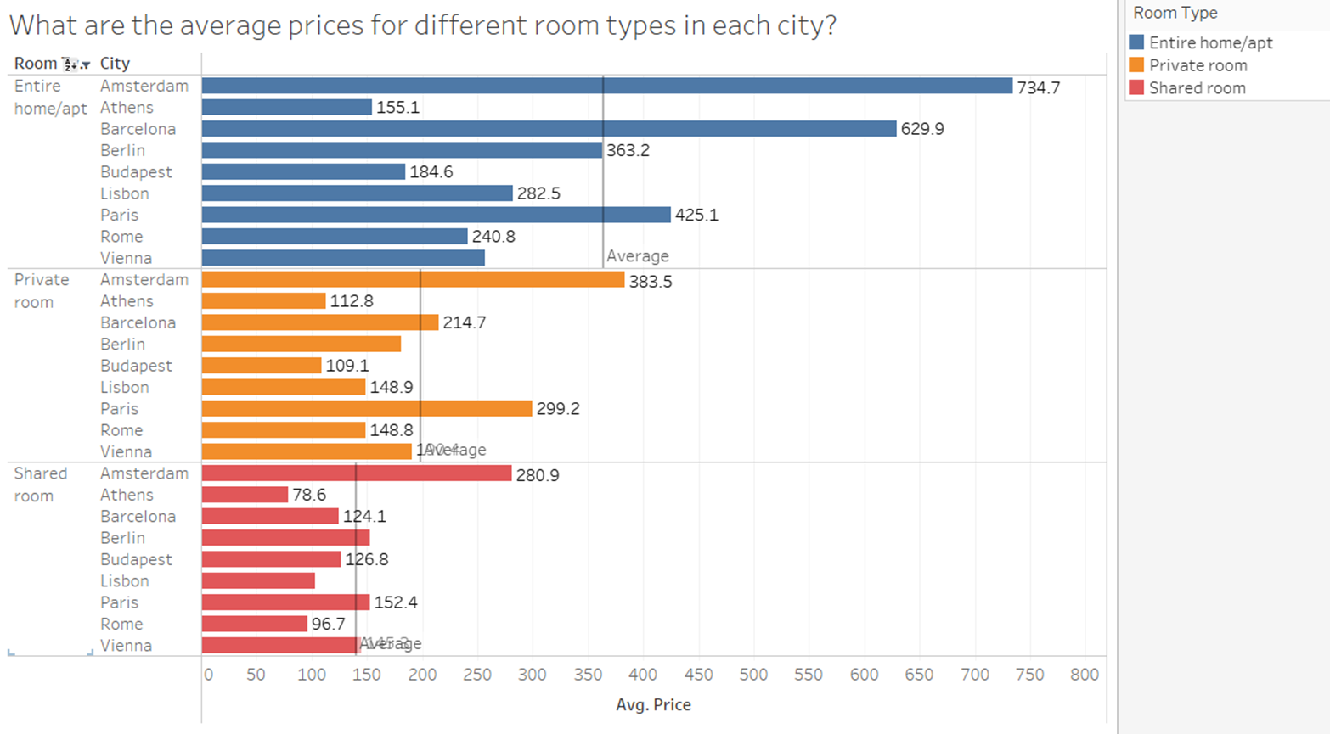

Slide 11



Slide 12
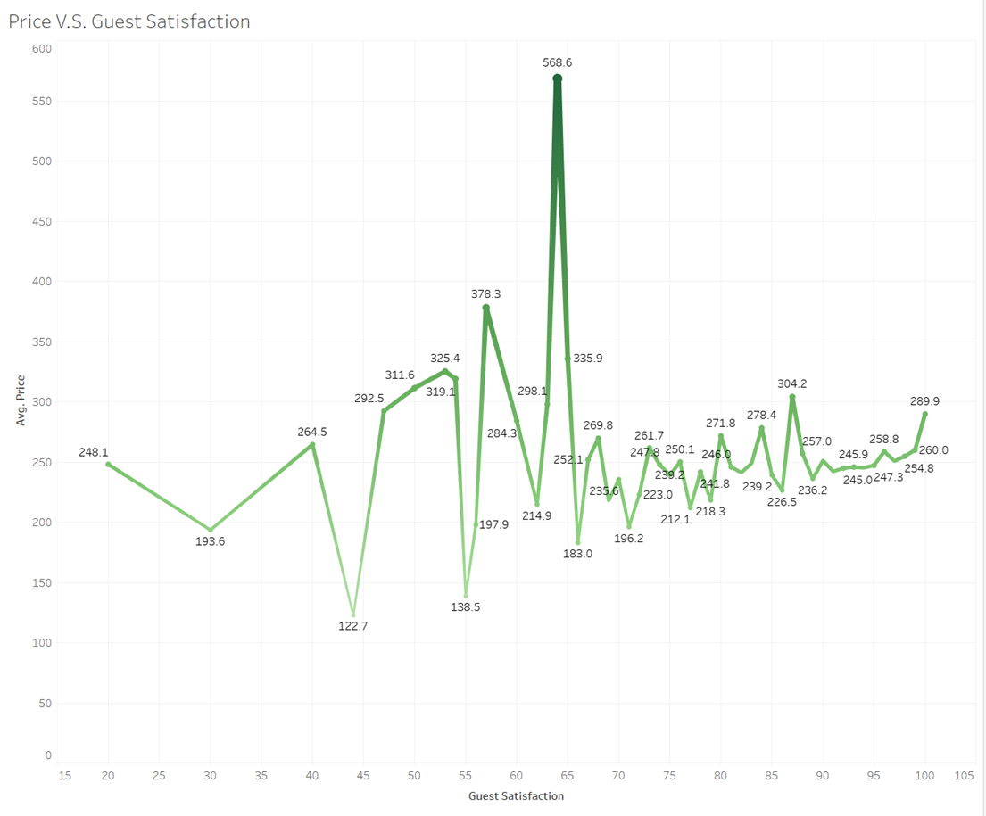
The relationship between customer satisfaction and prices is not clear, but it can be observed that houses with higher average prices tend to have lower overall satisfaction. This could be due to difficulties in meeting customer expectations.

Slide 13
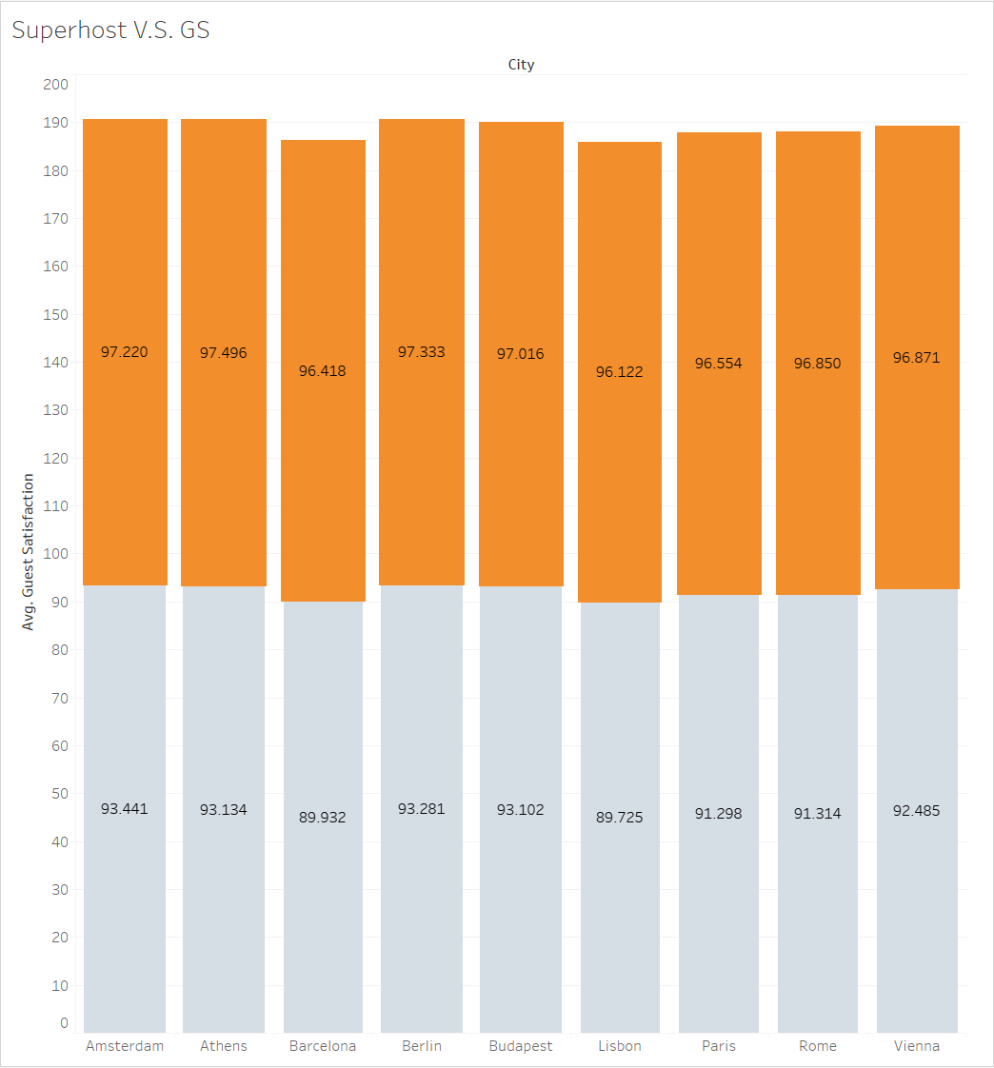
The average guest satisfaction of Superhosts is slightly higher than that of non-Superhosts, but the difference is not significant.

Slide 14
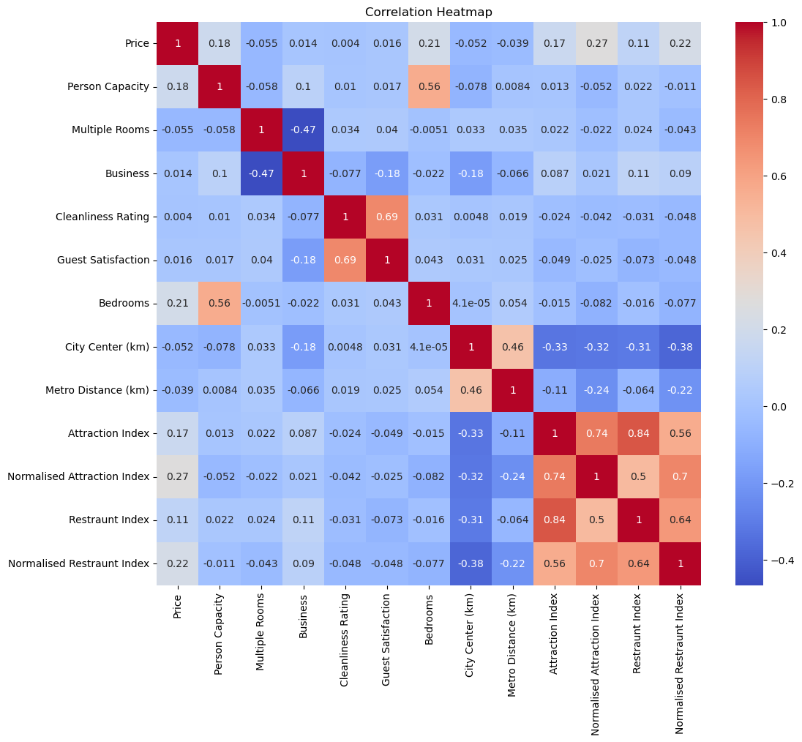
Who’s related?
Not many darker cells:
not much correlation
Main collinearity risk is with attraction and restaurant indices:
choose one
Highest correlation with Price:
0.27 normalized attraction index
Pearson’s r (default correlation)
may not be applicable to categoricals

Slide 15
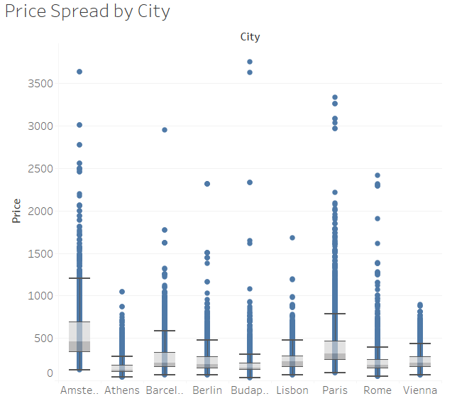
What’s so great about Amsterdam?
Large price spread by city
Amsterdam is clearly most expensive
Mentor: “don’t model on city”.
He was right.
Model results:
worse when cities excluded, but…
not good with them included
A prediction per city might’ve been more informative.

Slide 16
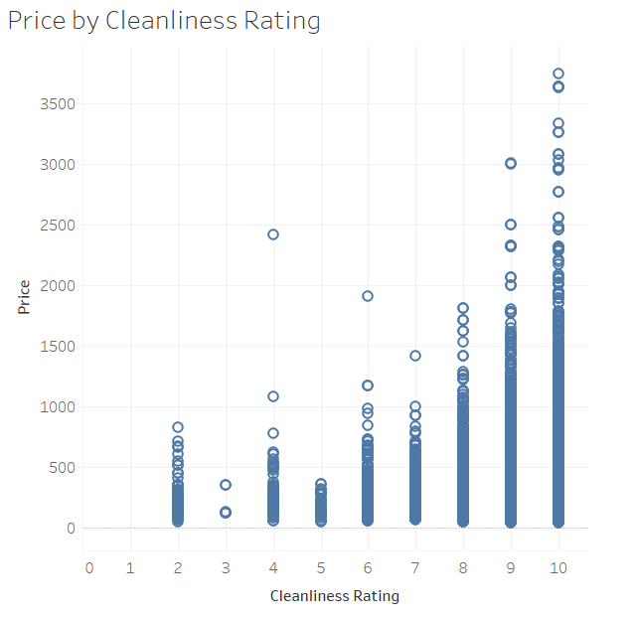
Two dots make a line…
People like clean rooms
People are willing to pay more for a clean room
This is not a line
There were other nonlinear relationships seen
Linear regression may just not work.

Slide 17
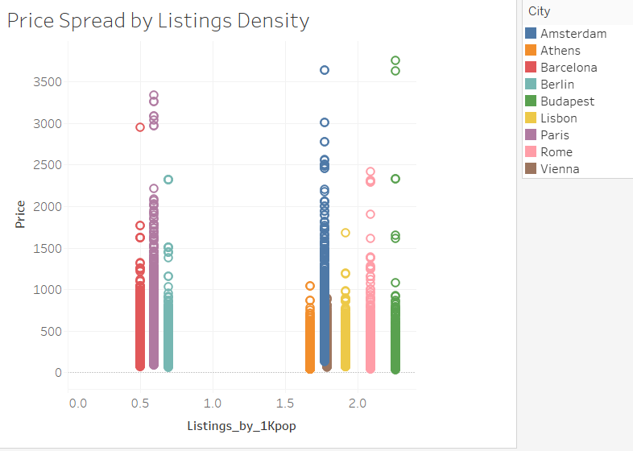
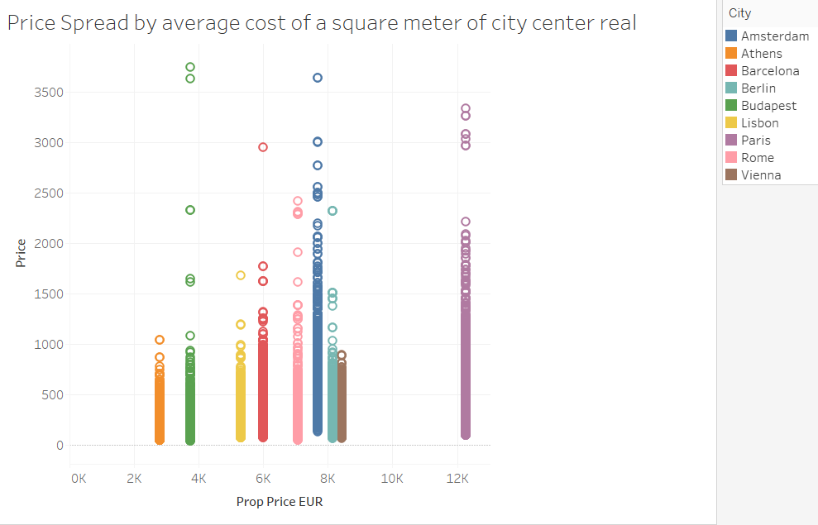
More data helps, right?
Added in Tableau:
population data
cost of real estate
Calculate “listings density”
listings by 1000 inhabitants
Still no definitive patterns

Slide 18
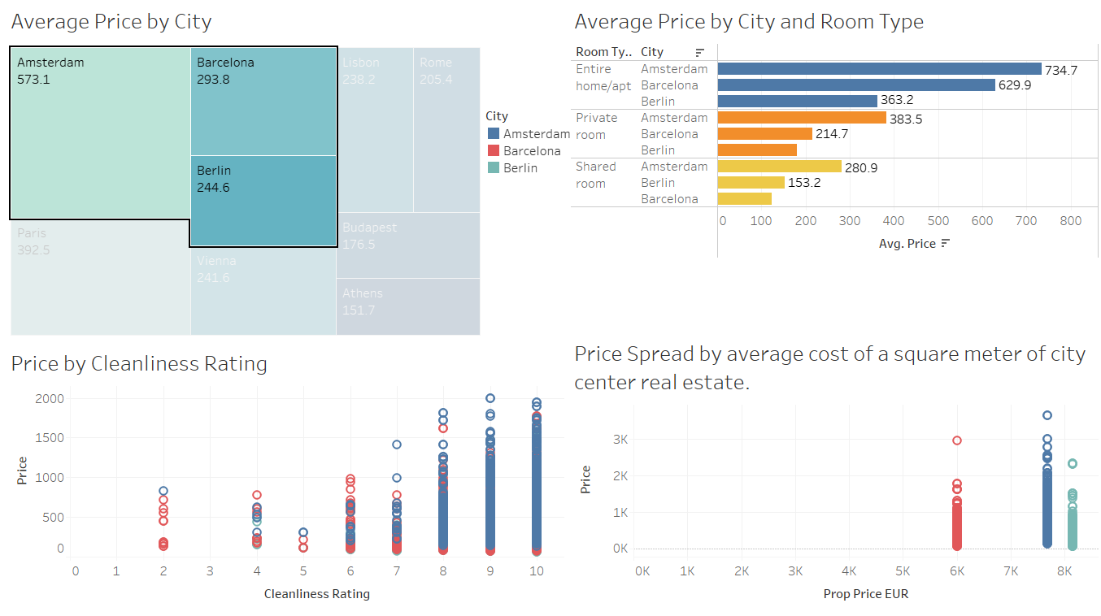

Slide 19
Modelling requires tune-ups
You may have clean data
You may also have complex relationships
EDA should provide clues on the model frameworks to trial
Results should inform your next iteration
results
model
data

Slide 20
What went well… …what didn’t
Win
Data selection was quick
Code was quickly produced
WIN
Working with very divergent schedules
LoSS
GitHub during code development
Synching difficulties near the end
Loss
Presentation content alignment
Communication styles vary
Goals can be misaligned

